Slide 1
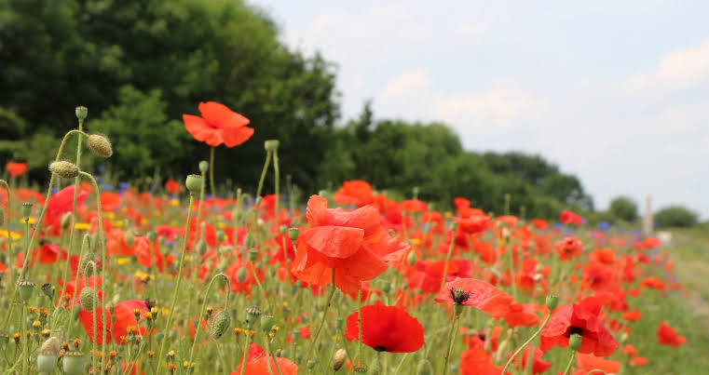
Remembrance Day

Slide 2
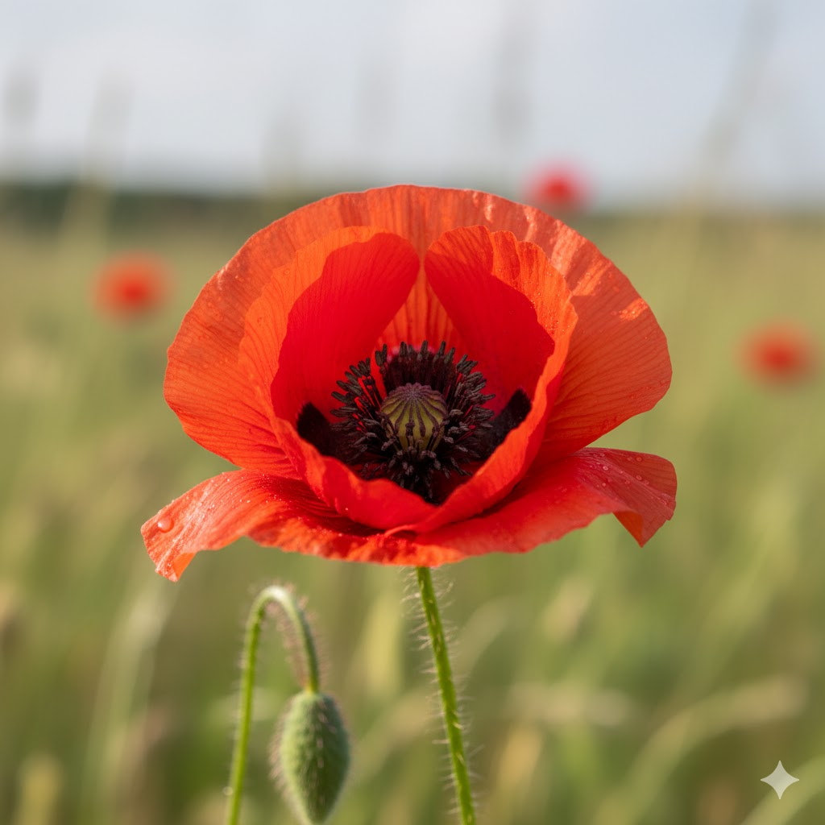
What is this flower?
This is a poppy.
© Get Reading Right

Slide 3
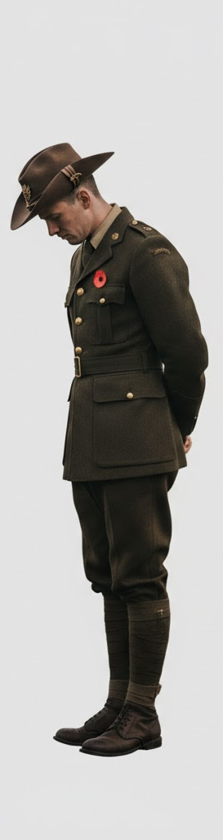
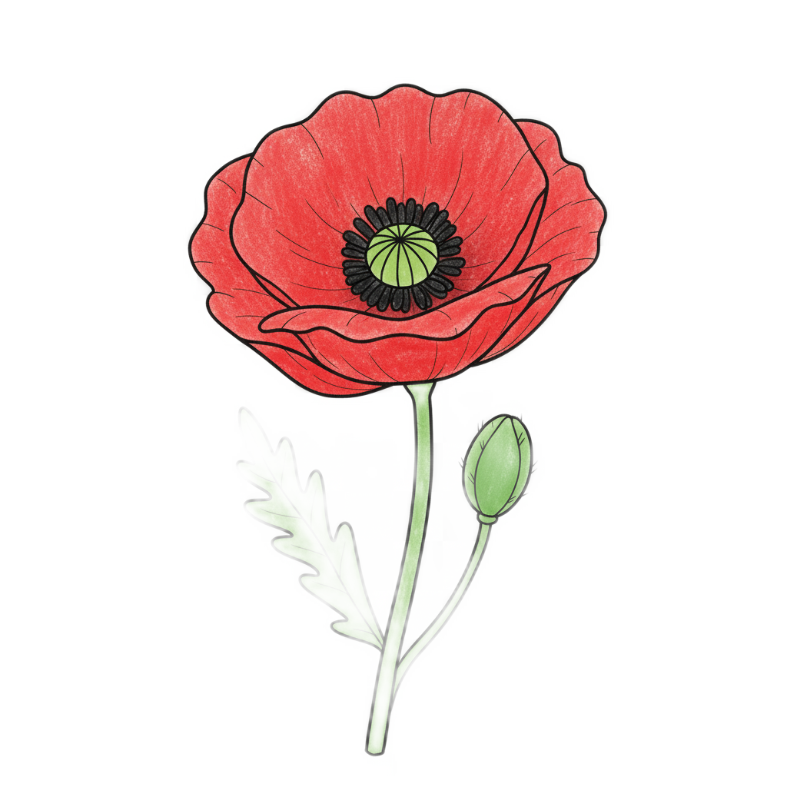
This is a special flower.
This special flower helps us
remember brave people.
© Get Reading Right

Slide 4
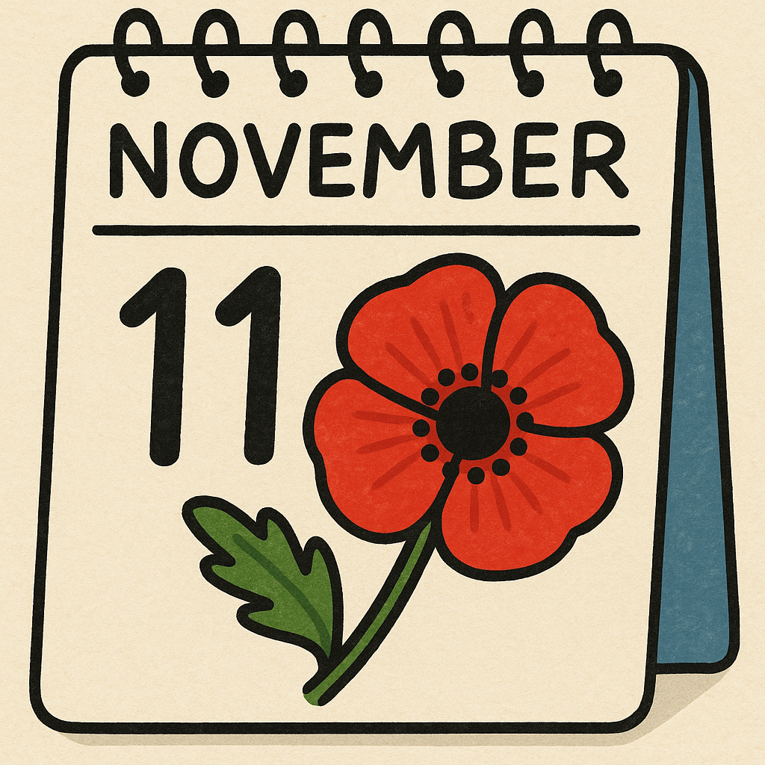
What day?
It happens every year on November 11th.
© Get Reading Right

Slide 5


A day to say thank you!
It’s a day for all of us in Australia to stop and say a big thank you to soldiers who worked hard long ago to keep our country safe.
© Get Reading Right

Slide 6
Brave men and women
Long ago, men and women went to far-away places to help. They were very brave and sometimes they got hurt.
We don't talk about the fighting; we talk about their kindness and bravery.
© Get Reading Right

Slide 7
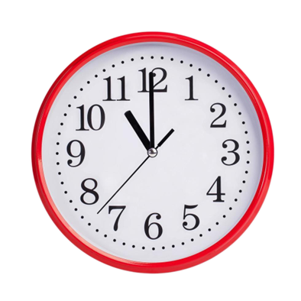
How can we remember them?
On Remembrance Day, at 11 o'clock, we all stand still and are quiet for one whole minute.
© Get Reading Right

Slide 8
Our feelings
Being quiet is a way to show respect. It means we are listening with our hearts. We are remembering their bravery and saying thank you in our minds.
© Get Reading Right

Slide 9
Let’s practice
Let's practice being super still and quiet for 10 seconds right now.
© Get Reading Right

Slide 10

Let’s make our own poppy
© Get Reading Right

Slide 11
